Slide 1
系統設計書—牙科處置
medcloud-dental-view
Product Owner | 孫培然
Scrum Master | 卓曉霜
Scrum Team | 駱彥丞、許家綺
2020.03.06編制

Slide 2
系統設計大綱
UI & Event Binding
ViewModel
View Service
WebAPI Controller
Model Service
Stored Procedure

Slide 3
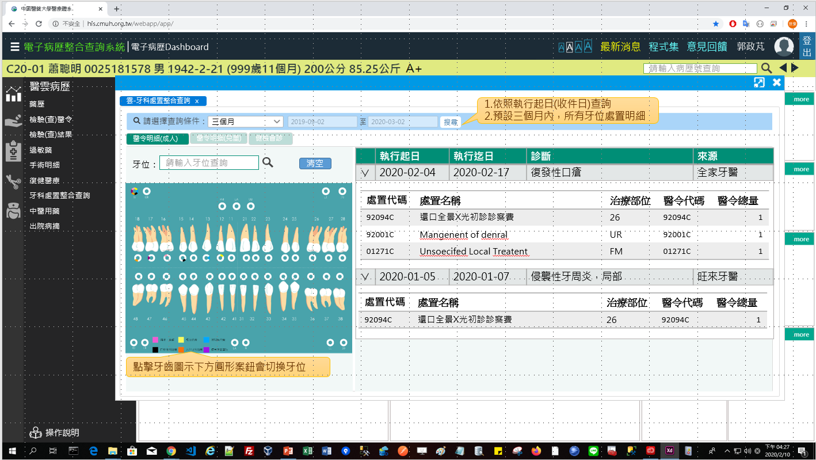
1. UI & Event Binding (1/3)-醫令明細(成人)
序 | 事件名稱
1 | onRangeChange($event)
2 | onSearchClick($event)
3 | onTabChange($event)
4 | onToothSearch($event)
5 | onClearClick($event)
6 | onToothPosClick($event)
❶
❷
❸
❹
❺
❻

Slide 4
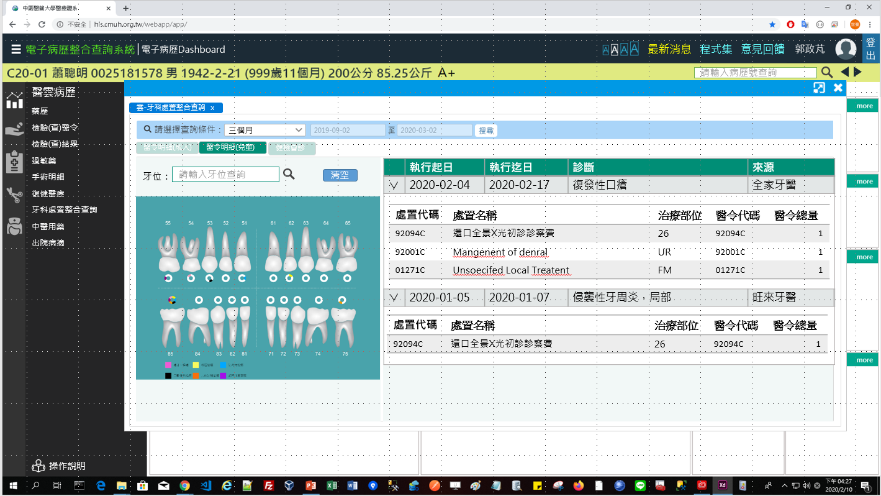
1. UI & Event Binding (2/3)-醫令明細(兒童)
序 | 事件名稱
1 | onRangeChange($event)
2 | onSearchClick($event)
3 | onTabChange($event)
4 | onToothSearch($event)
5 | onClearClick($event)
6 | onToothPosClick($event)
❶
❷
❸
❹
❺
❻

Slide 5
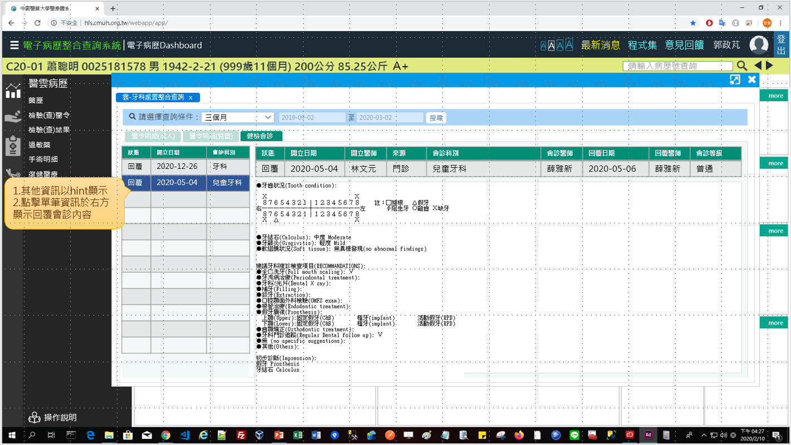
1. UI & Event Binding (3/3)-健檢會診
序 | 事件名稱
1 | onRangeChange($event)
2 | onSearchClick($event)
3 | onTabChange($event)
4 | onRowSelect($event)
❶
❷
❸
❹

Slide 6
2. View Model(1/2)
DateRange
Name |  | DataType
+ name | : | string
+ value | : | number
Dental
Name |  | DataType
+ idNo | : | string
+ startDate | : | date
+ endDate | : | date
+ diagName | : | string
+ hospitalName | : | string
+ dentalDetails | : | DentalDetail[]
DentalDetail
Name |  | DataType
+ treatCode | : | string
+ treatName | : | string
+ treatSite | : | string
+ nhiCode | : | string
+ orderQty | : | number
SearchReq
Name |  | DataType
+ idNo | : | string
+ startDate | : | date
+ endDate | : | date
SearchLog
Name |  | DataType
+ type | : | number
+ systemTime | : | datetime
+ systemUser | : | number
Column
Name |  | DataType
+ field | : | string
+ header | : | number
Notes:
reportUserTitle必須用
reportUser(員工代碼)到Employee查詢Title 職稱編號
再使用 titleNo到JobTitle查TitleName

Slide 7
2. View Model(2/2)
ConsultRecord
Name |  | DataType
+ consultNo | : | number
+ consultStatus | : | string
+ applyDate | : | date
+ requestDivNo | : | string
ConsultRecordDetail
Name |  | DataType
+ consultNo | : | number
+ consultStatus | : | string
+ applyUser | : | string
+ visitType | : | string
+ requestDivName | : | string
+ requestUser | : | string
+ replyDate | : | date
+ replyUser | : | string
+ consultType | : | number
+ content | : | string
Notes:
reportUserTitle必須用
reportUser(員工代碼)到Employee查詢Title 職稱編號
再使用 titleNo到JobTitle查TitleName

Slide 8
3. View Service
Page | Description | Property / Event | View Service | Input | Output
牙科處置 | 畫面初始設定 | ngOnInit() | getDentalList() | SearchReq | Dental[]
 | 取得牙科處置 | onSearchClick($event) | getDentalList () | SearchReq | Dental[]
健檢會診 | 畫面初始設定 | ngOnInit() | getConsultRecordList() | SearchReq | ConsultRecord[]
 | 取得健檢會診 | onSearchClick($event) | getConsultRecordList() | SearchReq | ConsultRecord[]
 | 取得會診詳細內容 | onRowSelect($event) | getConsultRecordDetail() | consultNo | ConsultRecordDetail
紀錄 | 儲存查詢紀錄 | (尚待規劃) |  | SearchLog | Boolean

Slide 9
6. Stored Procedure
<註> 副主任指示現階段直接用NodeJs寫Sql抓informix，所以無stored procedure (2020-03-12)

